Slide 1
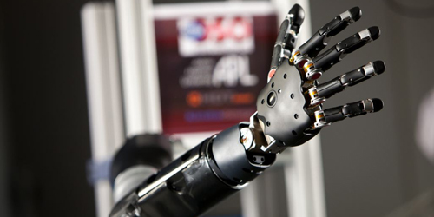
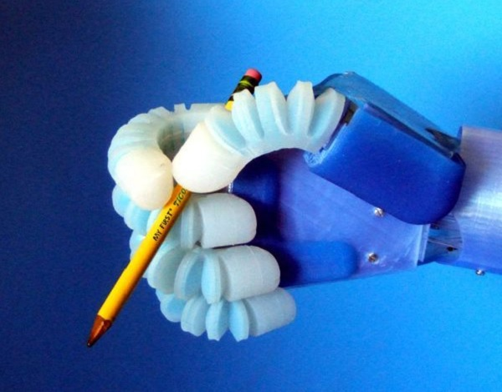

Electroactive Polymer Implementation into Prosthetic Adaptive Socket
The over-arching goal of this
project is to do the fundamental
science research to transform the
socket design, the key interface
between the prosthesis and the
amputee, in order to improve the
functionality and comfort of the
upper limb prosthesis.
Christopher Shallal, JHU

Slide 2
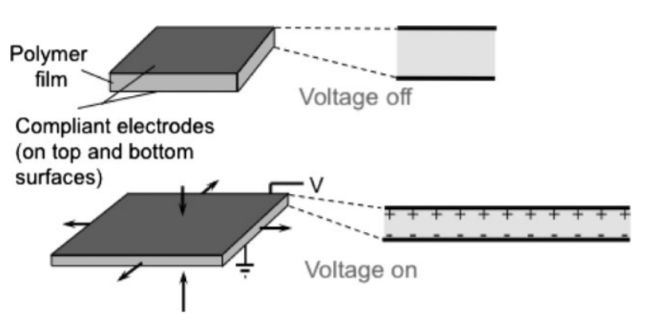
O’Halloran, Ailish, Fergal O’malley, and Peter McHugh. "A review on dielectric elastomer actuators, technology, applications, and challenges." Journal of Applied Physics 104.7 (2008): 9.
Overview of Dielectric Elastomer Actuators:
Dielectric elastomer actuators are referred to as artificial muscles.
Large range of actuation strain, speed, low density, compliant nature, and silent operation actuation.
Potential for multiple degrees of freedom (rotational and translational)
Transform electric energy into mechanical work
Active expansion creates passive contraction among the polymer
A closed loop control can be created to regulate the changes in voltage, capacitance and resistance given to the polymer.
Biological model of the muscle
Dielectric polymers are electrically driven and can provide a feedback signal for self-sensing and control
Christopher Shallal, JHU

Slide 3
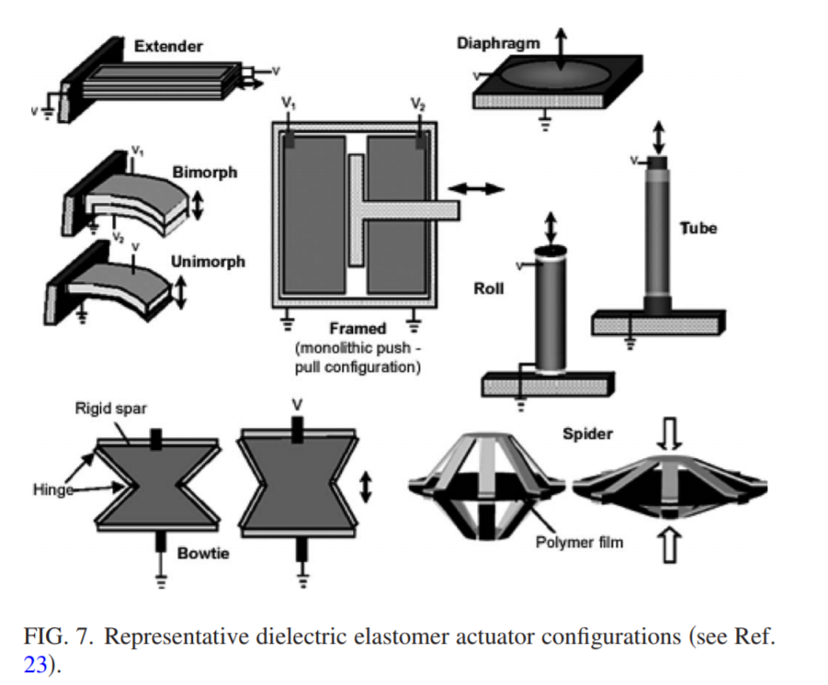
Different Actuation Methods for Dielectric Elastomer Actuators
O’Halloran, Ailish, Fergal O’malley, and Peter McHugh. "A review on dielectric elastomer actuators, technology, applications, and challenges." Journal of Applied Physics 104.7 (2008): 9.
Christopher Shallal, JHU

Slide 4
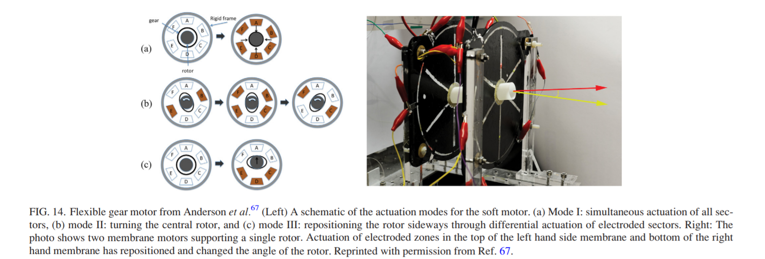
Presented is a soft, bearing-free artificial muscle motor that cannot only turn a shaft but also grip and reposition it through a flexible gear. The bearing-free operation provides a foundation for low complexity soft machines, with multiple degree-of-freedom actuation, that can act simultaneously as motors and manipulators. The mechanism also enables an artificial muscle controlled gear change. This type of actuation could be implemented into a prosthetic socket to shift the angular orientation into a more comfortable position, as detected by a pressure sensor array.
Anderson, Iain A., et al. "Multi-functional dielectric elastomer artificial muscles for soft and smart machines." Journal of Applied Physics 112.4 (2012): 041101.
Christopher Shallal, JHU

Slide 5
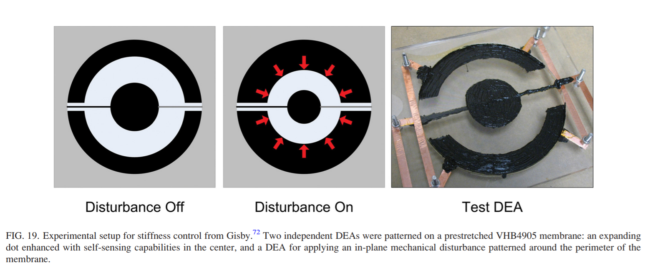
Anderson, Iain A., et al. "Multi-functional dielectric elastomer artificial muscles for soft and smart machines." Journal of Applied Physics 112.4 (2012): 041101.
This type of radial actuation could be easily integrated into the socket to prevent constant residual limb movement and shifting and to provide the user with a tightened fit in the socket. This can potentially be a perfect substitute for the rigid socket design that has been a major problem in prosthetic devices.
Christopher Shallal, JHU

Slide 6
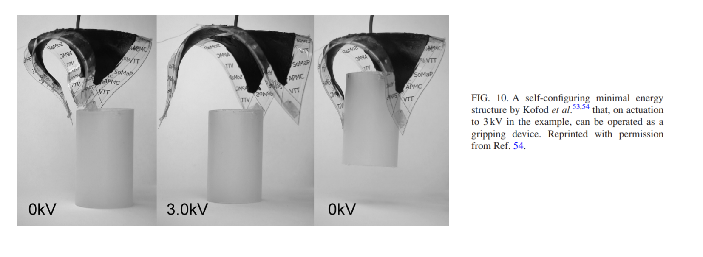
Anderson, Iain A., et al. "Multi-functional dielectric elastomer artificial muscles for soft and smart machines." Journal of Applied Physics 112.4 (2012): 041101.
This method of gripping actuation can be either utilized in adaptive sockets or prosthetic hands. These dielectric elastomers could provide a stable mechanism to hold residual limbs in place or be integrated into hands for gripping use.
Christopher Shallal, JHU

Slide 7
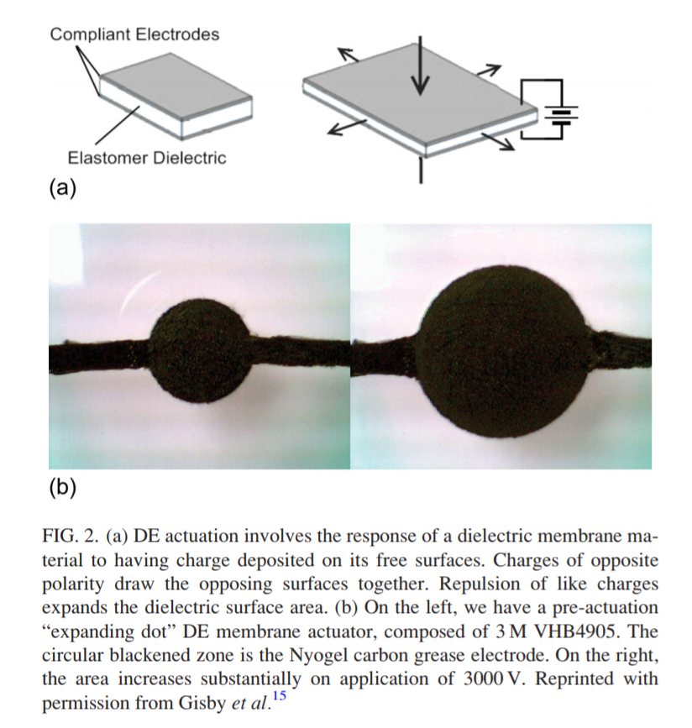
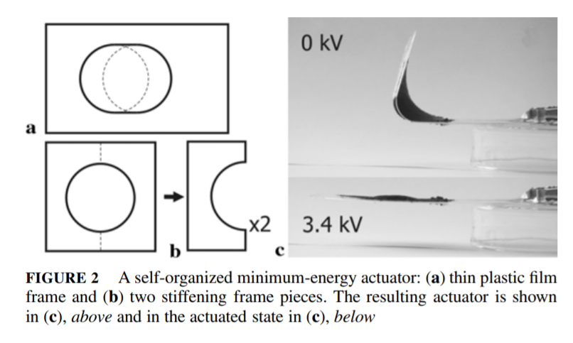
Anderson, Iain A., et al. "Multi-functional dielectric elastomer artificial muscles for soft and smart machines." Journal of Applied Physics 112.4 (2012): 041101.
Christopher Shallal, JHU

Slide 8
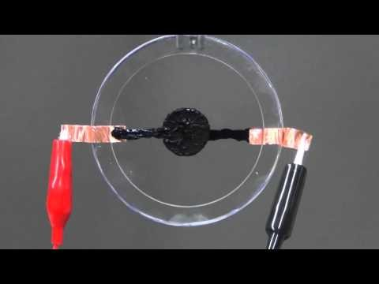
Dielectric Actuation in Action
Christopher Shallal, JHU

Slide 9
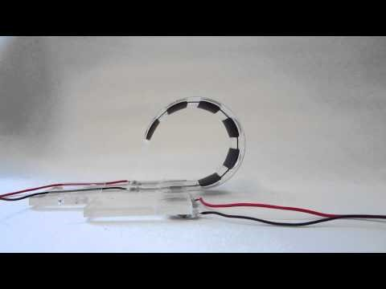
Dielectric Actuation in Action – Gripping Technology
Christopher Shallal, JHU

Slide 10
Dielectric Potential Manufacturing
Brief Overview: There are many different methods to approaching the fabrication of dielectric manufacturing. 3D printing seems the most logical route, whether that be through stereolithography or fused layer deposition. The elastomer material that can be printed is affordable, and these processes allow for quick prototyping and advanced CAD models to be used to create unique actuation methods.
Christopher Shallal, JHU

Slide 11
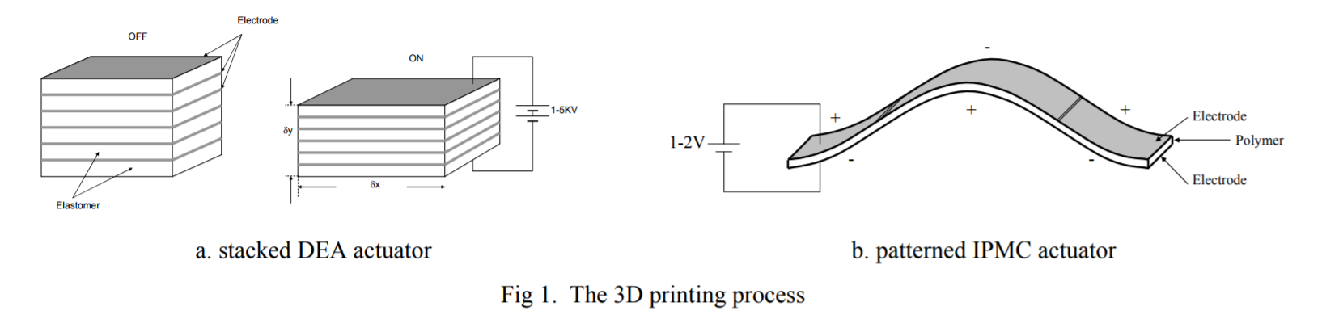
3D Printing Dielectric Elastomer Actuators
Rossiter, Jonathan, Peter Walters, and Boyko Stoimenov. "Printing 3D dielectric elastomer actuators for soft robotics." Electroactive Polymer Actuators and Devices (EAPAD) 2009. Vol. 7287. International Society for Optics and Photonics, 2009.
The figure below is an example of how 3D printing can cause actuation movement in multiple directions. With this 3D structure implemented, multi-layered actuators can be created. The elastomer is first 3D printed, and then an electrode layer is applied to the polymer. A voltage is then applied to the elastomeric material, and the soft membrane reacts based on the hard frame it is placed within. A hard shell for a prosthetic can be made and then elastomer layers arrayed inside of it. The actuation direction would be controlled by the hard shell of the socket.
The main factor is to translate from 2D to 3D actuators. One manufacturing approach is to utilize 3D printing technology to layer dielectric elastomers and their respective electrode coatings. Actuator layers can be created at different angles. This method would allow for easy prototyping and quick fabrication of electroactive polymer actuators.
Christopher Shallal, JHU

Slide 12
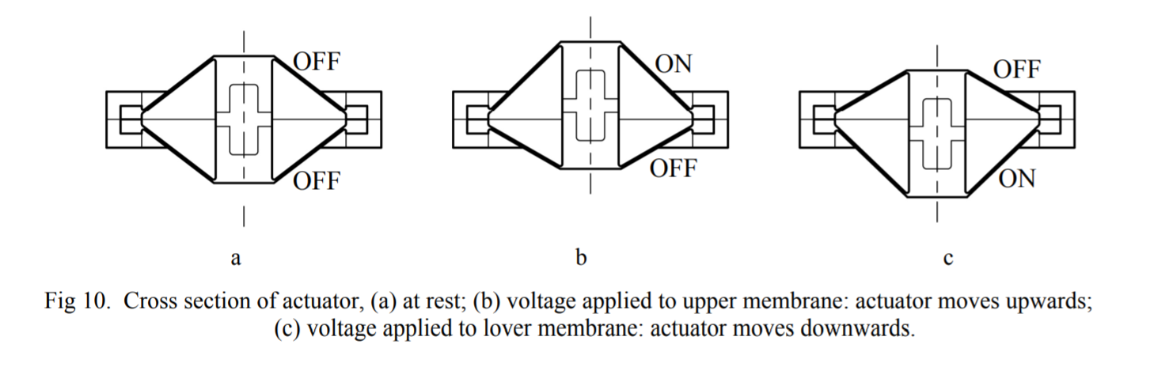
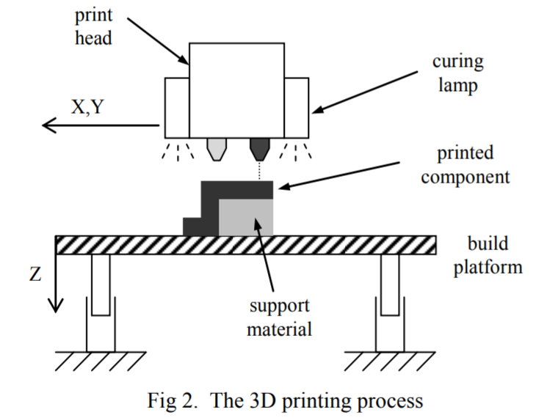
Rossiter, Jonathan, Peter Walters, and Boyko Stoimenov. "Printing 3D dielectric elastomer actuators for soft robotics." Electroactive Polymer Actuators and Devices (EAPAD) 2009. Vol. 7287. International Society for Optics and Photonics, 2009.
The figure above shows this paper’s utilization of the soft photo-polymer material encased in a rigid membrane, which was used to control the direction of actuation. The electroactive polymer actuated into two directions, up and down, but the shell could be created to actuate into multiple different directions. This actuator structure can be redesigned to fit the dimensions of a prosthetic socket and actuate radially to address internal pressures within the socket. The figure to the right demonstrates the additive manufacturing process adapted to printing elastomers.
Christopher Shallal, JHU

Slide 13
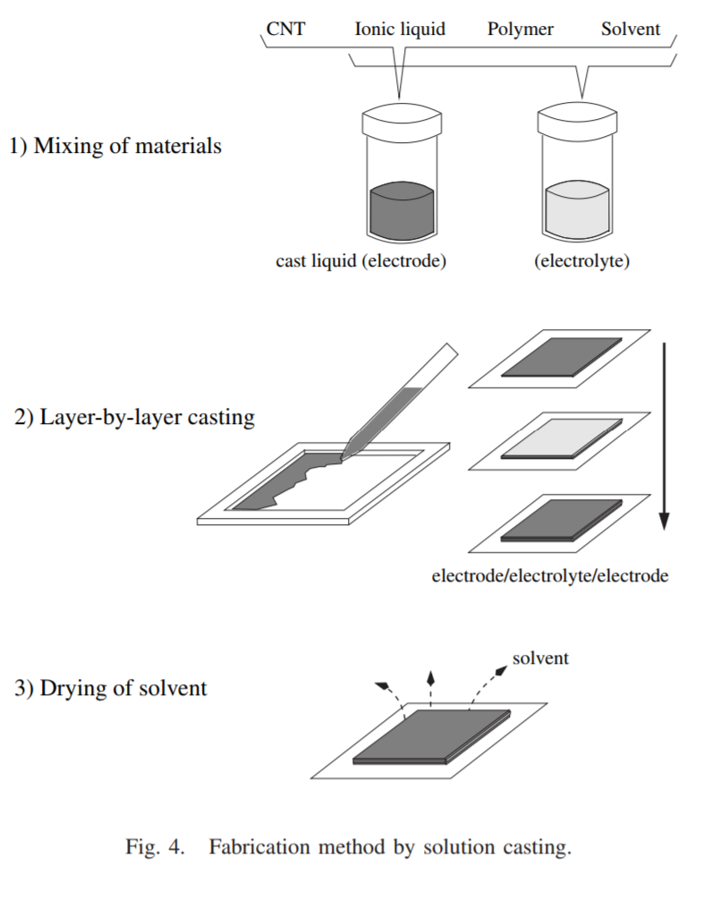
Common Method to create Electroactive Polymers
The method shown to the left is the most common process to create electroactive elastomers. While not being a dielectric polymer, it is created from bucky gel. Bucky gel is a type of actuator material that can manufactured layer by layer, allowing for specific shapes and designs. If dielectric printing presents a problem in terms of complexity, bucky gel can serve as an alternative for fabrication.
Kamamichi, Norihiro, et al. "Fabrication of bucky gel actuator/sensor devices based on printing method." Intelligent Robots and Systems, 2008. IROS 2008. IEEE/RSJ International Conference on. IEEE, 2008.
Christopher Shallal, JHU

Slide 14
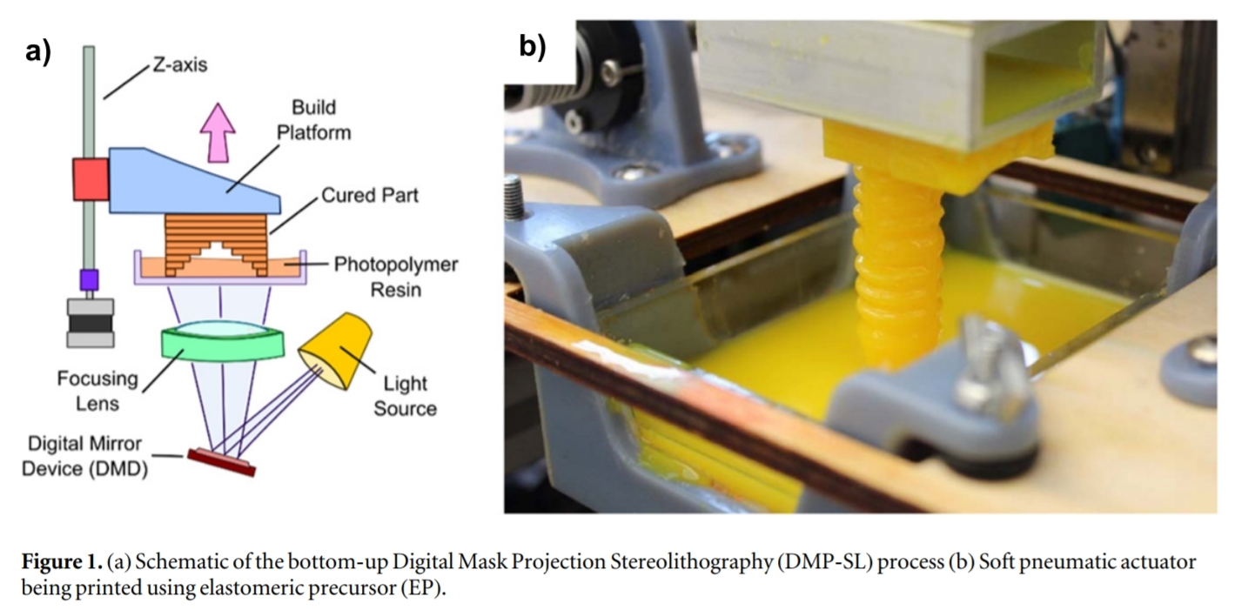
Projection Stereolithography
Instead of fused 3D deposition modeling, this paper suggests stereolithography is the best additive manufacturing process to create elastomers. Stereolithography leads to high degrees of freedom and rapid prototyping. The material is easily aligned, not require support material and print at very high resolutions (the design of a socket would have to be very precise to give the user the most comfort and fit). While this paper only details the specific manufacturing of a soft pneumatic actuator, the elastomeric manufacturing process can be used for dielectric creation.
Peele, Bryan N., et al. "3D printing antagonistic systems of artificial muscle using projection stereolithography." Bioinspiration & biomimetics 10.5 (2015): 055003.
Christopher Shallal, JHU

Slide 15
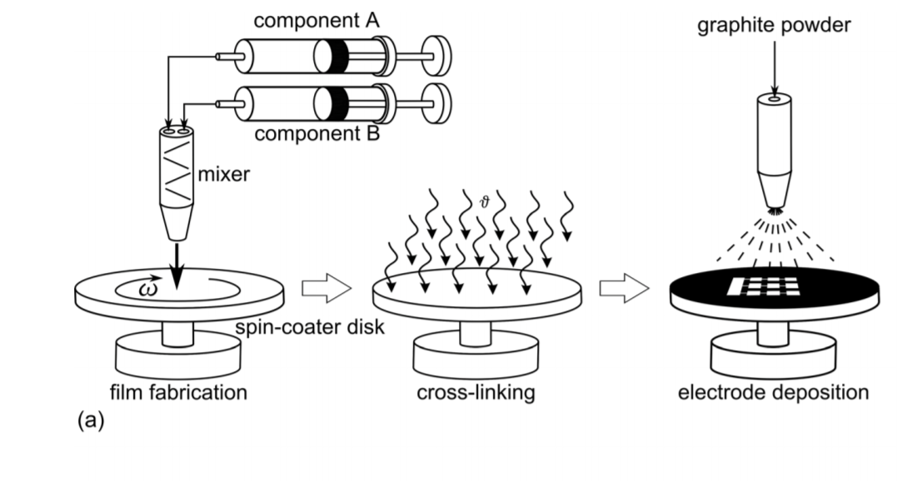
Fabrication for Multi-Layer Actuators
Anderson, Iain A., et al. "Multi-functional dielectric elastomer artificial muscles for soft and smart machines." Journal of Applied Physics 112.4 (2012): 041101.
Christopher Shallal, JHU

Slide 16
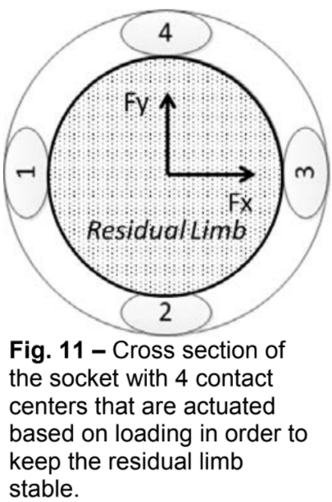
Implementation into Socket
The figure to the left describes how actuation would be oriented within the socket. Based on a novel pressure sensory array that is internally aligned within the socket, we can relay that spatial and pressure distribution to a controller, which would regulate the voltage given to the dielectric elastomers. This technology would pave the way for a truly adaptive socket, one that did not have a rigid socket anymore but was made of the electroactive polymers.
Christopher Shallal, JHU

Slide 17
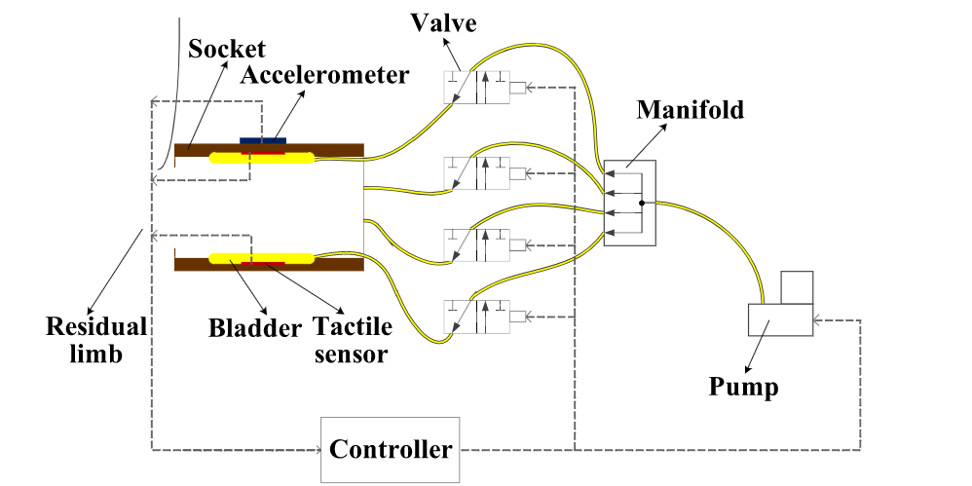
Precedent in JHU Neuroengineering and Biomedical Instrumentation Lab
A student at the Johns Hopkins University Neuroengineering lab previously worked on creating an adaptive socket that responded to pressure feedback from tactile sensors and adjusted the residual limb position using a pneumatic bladder system to give more comfort to the user. This gives the lab a background in utilizing actuation techniques to increase comfort within the prosthetic socket.
Christopher Shallal, JHU

Slide 18
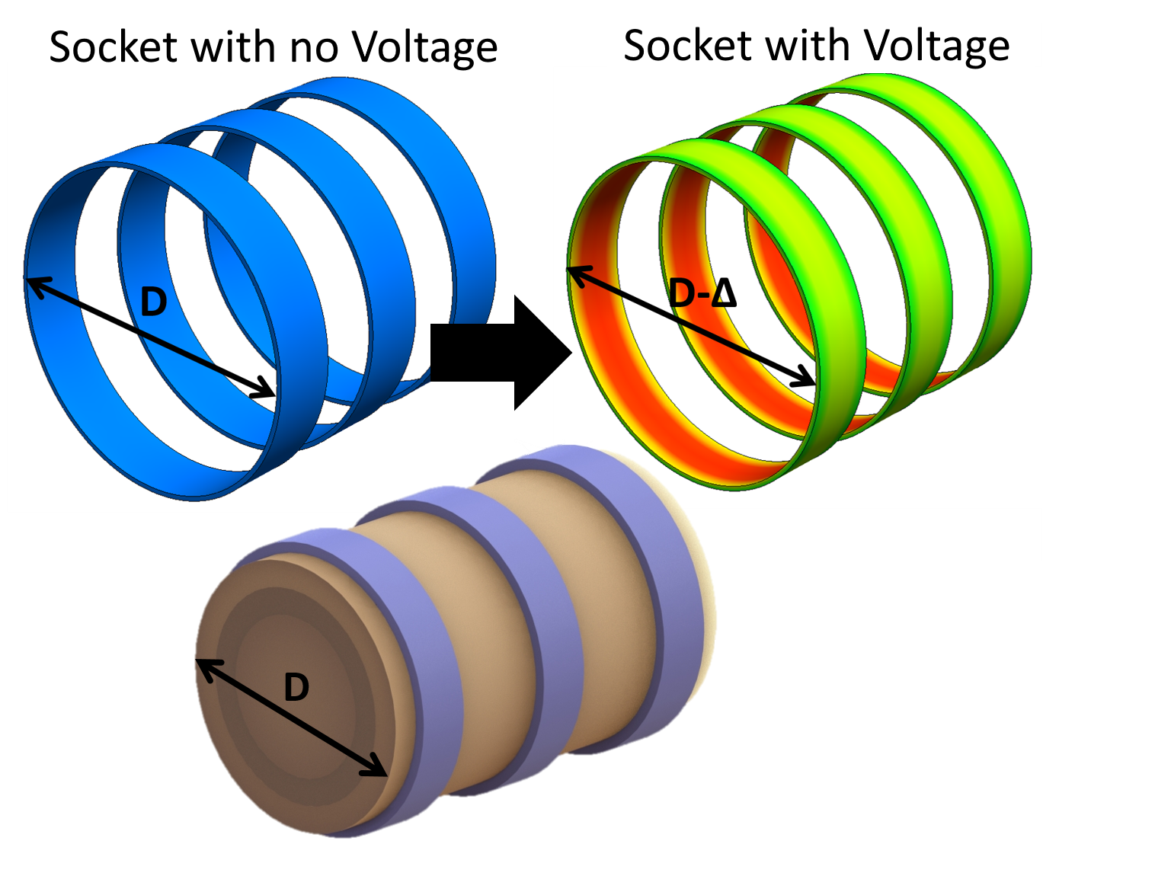
Depiction of variable voltage and the socket diameter changing
Christopher Shallal, JHU

